Slide 1
Socioeconomic inequalities in childhood and adolescent body-mass index, weight, and height from 1953 to 2015: an analysis of four longitudinal, observational, British birth cohort studies
David Bann
William Johnson, Diana Kuh, Leah Li, Rebecca Hardy

Slide 2
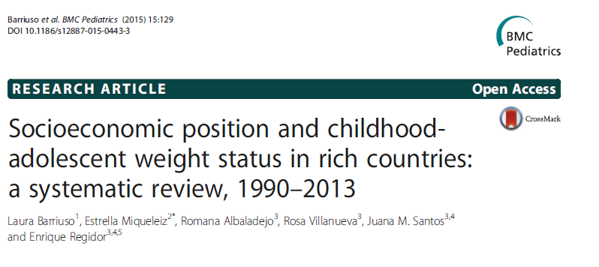
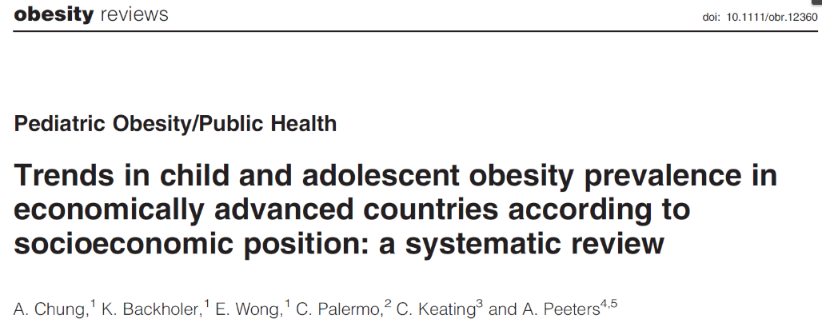


Slide 3
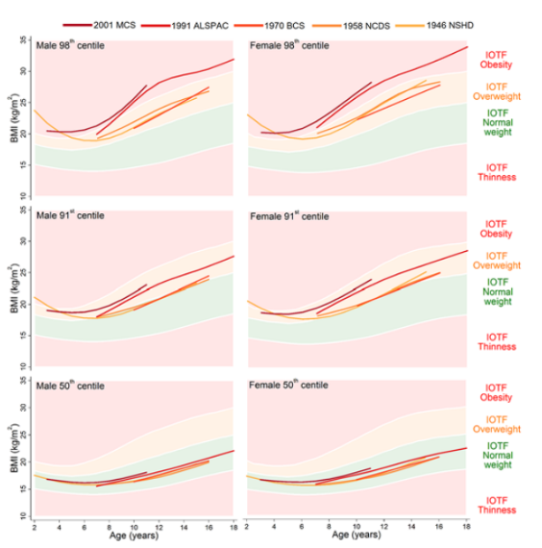
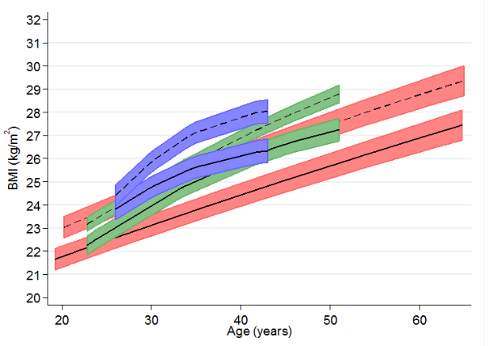
Background
BMI inequalities exist, unclear how changed
  Small timespan, gaps, & different methods
Not well understood:
  Separate components of BMI: weight & height
  Nature of inequality across outcome distribution
    Partly underlie increasing right-skew of BMI?
    Not addressed using linear/logistic regression
  Δ age (not focus of this presentation)
Johnson et al, PLOS Med ,2015; Bann et al, PLOS Med, 2017

Slide 4
Objectives
Examine inequalities in child-adolescent height, weight & BMI
  1946 MRC National Survey of Health and Development
  1958 National Child Development Study
  1970 British Cohort Study
  2001 Millennium Cohort Study
    Long-run comparison (1953 to 2015)
    ~Nationally representative

Slide 5
Methods – data
Weight, height and BMI measurement
  1946: 7, 11, 15 years
  1958: 7, 11, 16
  1970 10, 16
  2001: 7, 11, 14
  Father’s social class at 10/11y (RGSC)
    Mother’s used if no father-figure present in 2001 (N=1928)
    Ridit score – slope index inequality
  Sensitivity analysis:
    Repeated using maternal education; less missing data but less information (0/1) / comparable

Slide 6
Analytical strategy
Centered outcomes at same age: 11y
  (Results similar before this, or when converting to z-scores)
Cross-cohort comparability:
  Participant selection: immigrants, NI, twins excluded
  Survey weights: 1946, 2001
Mean difference in outcome in lowest/highest SEP: sex-adj linear regression
SEP differences at different points of the outcome distribution
  Sex-adj quantile regression at 5th, 10th, 25th, 50th (median), 75th, 90th, 95th

Slide 7
Results: means at 11y
Cohort | N | BMI, kg/m² | Weight, kg | Height, cm
1946 | 3629 | 17.4 | 35.2 | 141.6
1958 | 11193 | 17.3 | 35.1 | 142.3
1970 | 11231 | 17.4 | 35.8 | 142.2
2001 | 8820 | 18.9 | 40.5 | 145.7

Slide 8
Results: slope index of inequality at 11y
Cohort | N | BMI, kg/m² | Weight, kg | Height, cm
1946 | 3629 | 0.0 (-0.2, 0.3) | -1.9 (-2.7, -1.1) | -4.1 (-4.9, -3.3)
1958 | 11193 | 0.0 (-0.2, 0.1) | -1.8 (-2.3, -1.3) | -3.5 (-3.9, -3.0)
1970 | 11231 | 0.1 (0.0, 0.3) | -1.0 (-1.3, -0.6) | -2.7 (-3.1, -2.3)
2001 | 8820 | 1.3 (0.9, 1.6) | 2.1 (1.2, 2.9) | -1.2 (-1.7, -0.6)

Slide 9
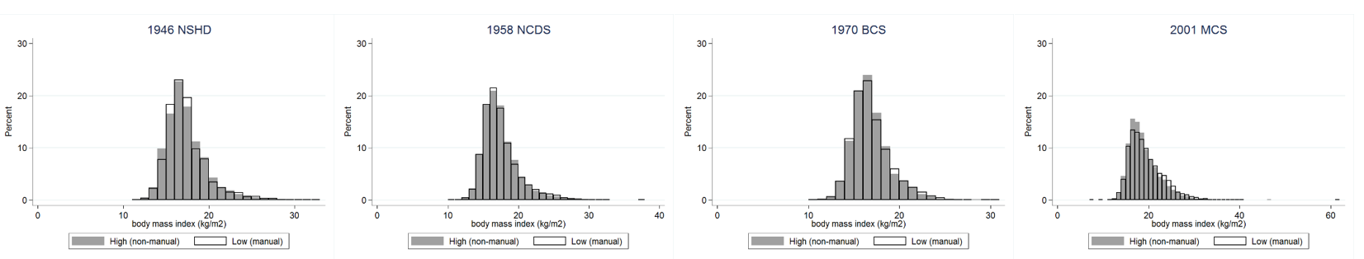
Results: histograms at 11y, by social class

Slide 10
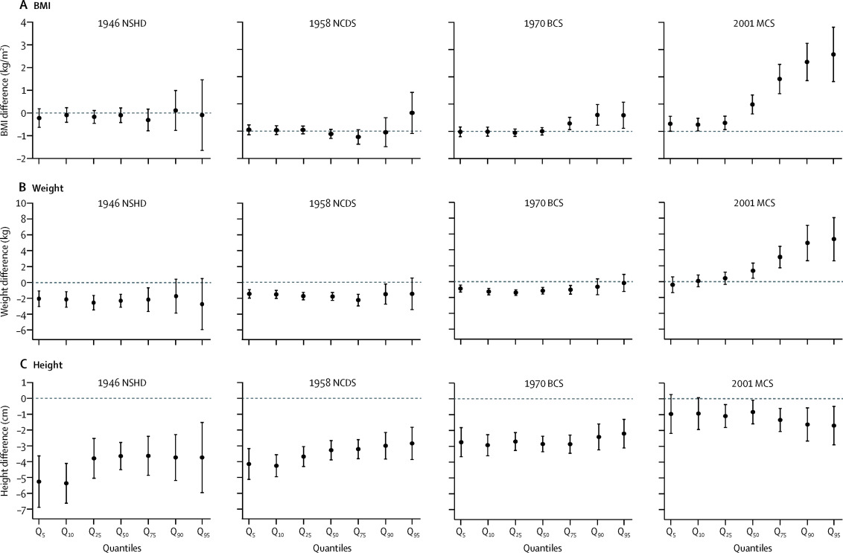
11y: BMI, weight, height quantile regression

Slide 11
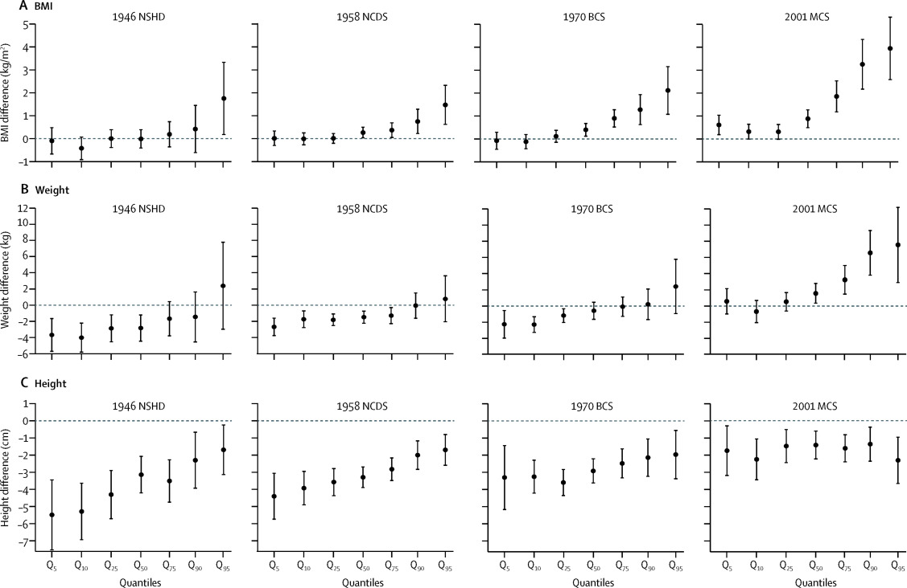
15y: BMI, weight, height quantile regression

Slide 12
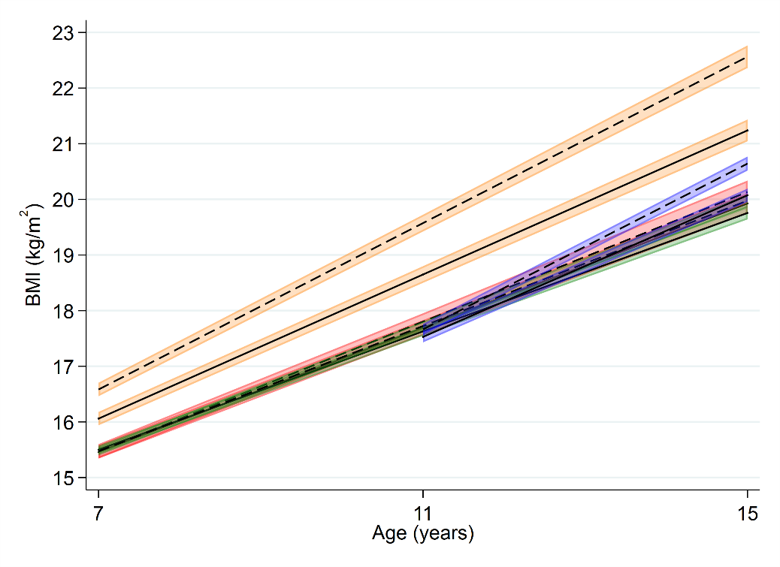
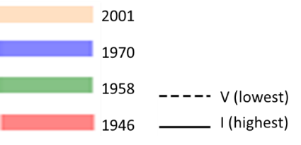
7-15y: BMI multilevel regression,
Body mass index (BMI) across childhood and adolescence in relation to father’s social class in 1946, 1958, 1970, and 2001 British birth cohort studies. Note: lines show estimated BMI along with 95% confidence intervals at each age among women, estimated using multilevel general linear regression models (full model estimates shown in S3 Table).

Slide 13
Summary of findings & comparison
From 1953 to 2015, absolute inequalities in:
  Height narrowed
  Weight reversed
  BMI emerged
    Larger at higher end of distribution
    Widened from childhood-adolescence
Widening BMI inequalities in recent decades
  Consistent with cross-sectional, 2-cohort comparisons
  Distributional effects – may underlie secular skewing of BMI distribution
Stamatakis et al, 2010; White et al, 2016; Shackleton et al, 2015; Johnson et al, 2015

Slide 14
Potential explanations
Social distribution of the determinants of weight/height
Diet & PA challenging to measure
Despite rationing, inequalities in diet evident at 4y in 1946c:
  Lower SES -> ↓ total calories likely reversed in 2001
  ↓ micronutrients (eg, Zinc) potentially narrower in 2001
      lower infectious disease parental obesity in 2001
Distributional effects
Larger SEP impact among those who…
for environmental / genetic reasons, more susceptible to higher BMI
Prynne et al, 2002; Mayo‐Wilson et al, 2014; Goisis et al, 2015; Costa et al, 2015

Slide 15
Strengths & limitations
4 national studies, long-run investigation
  Analyses underpowered to detect SES differences in thinness, ethnic modification
  30-year gap from 1970 to 2001
Findings robust to fathers social class & maternal education
  Still crude SEP indicators & BMI !=fat
  Attrition could potentially bias
Causality not empirically demonstrated

Slide 16
Implications & policy considerations (assuming causal, robust etc)
Existing policies have not been effective in preventing BMI increase and emergence/persistence of BMI inequality up to 2015
  Widening w/age & expected to widen further (eg, to 60-64y in 2065)
  Urgent need to reduce BMI inequalities via effective policies

Slide 17
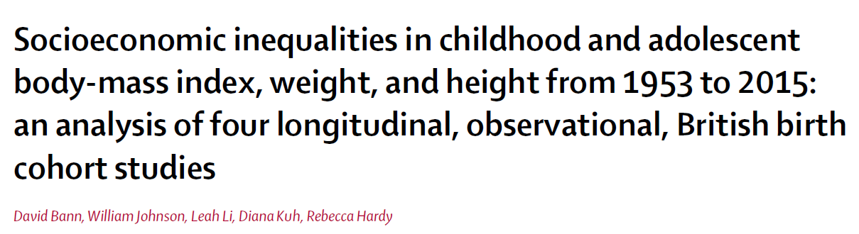

Acknowledgments
Co-authors (Rebecca Hardy & Will Johnson)
CLOSER (ESRC & MRC)
Colleagues, participants
david.bann@ucl.ac.uk
www.thelancet.com/journals/lanpub/article/PIIS2468-2667(18)30045-8/abstract

