Slide 1
An Introduction to the 1970 British Birth Cohort (BCS70)
David Bann

Slide 2
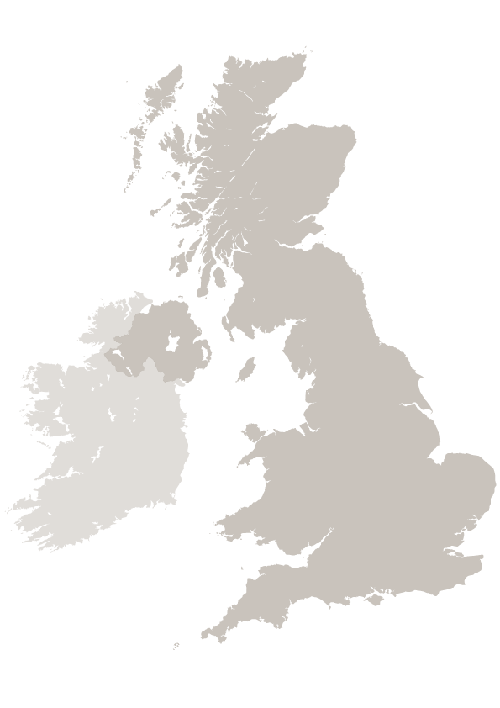
Brief Overview of BCS70
Data collected about births and families of just over 17,000 babies born in England, Wales, Scotland and Northern Ireland in one week in 1970
N.Ireland members not followed up after birth (unless moved to mainland)
Early focus was medical & has broadened :
Educational and physical development; Family formation, employment... adult identity etc
PI: Alice Sullivan
Lead study manager: Matt Brown

Slide 3

Sources of information
1970 | 1975 | 1980 | 1986 | 1996 | 2000 | 2004 | 2008 | 2012 | 2018
Birth | 5 | 10 | 16 | 26 | 29/30 | 34 | 38 | 42 | 46
Parent | Parent School | Parent School | Parent School Cohort member | Cohort member | Cohort member | Cohort member Children (1 in 2) | Cohort member | Cohort member | Cohort member
Medical | Tests Medical | Tests Medical | Tests Medical |  |  |  |  | Tests | Tests Medical
Respondents
Instruments
Cohort profile

Slide 4
Participation/response in BCS70 across life
Telephone
Missing data:
Reduces power and potentially introduces bias
Increasingly researchers can address this using data which predicts missingness (eg, early life socioeconomic circumstances)
eg, multiple imputation, FIML, inverse probability weighting
Postal
Telephone
Birth
5
10
16
26
30
34
38
42

Slide 5
Topics covered by life stage
Birth | School years | Adult
Family Parental employment Obstetric history Smoking in pregnancy Pregnancy (problems, antenatal care) Labour (length, pain relief, problems) Birth (problems, sex, weight, length) | Family Parental employment Financial circumstances Housing Health Behaviour School Views and expectations Attainment | Family (partners, children) Employment Income Housing Health Health-related behaviour Courses and qualifications Basic skills Cognitive ability Views and expectations

Slide 6
Childhood Topics 1
Parents | Birth | General
Smoking (0, 5, 10, 16) Drinking (10, 16) Pregnancy history Maternal mental health (5, 10, 16) | Smoking in pregnancy Pregnancy Labour Birth weight / length etc Problems at birth Breastfeeding | General health Child development Specific conditions Disabilities/ special needs Hospital admissions Use of services Immunisation Medication Accidents Menstruation

Slide 7
Childhood Topics 2
Childhood physical assessments | Lifestyle | Behavioural and mental
Height (5,10,16) Weight (5,10) Head circumf (5,10,16) Audiometry (10, 16) Laterality Speech Co-ordination Blood pressure/ pulse (10) Vision | Diet (10, 16) Eating problems (5; 10; 16) Exercise (10, 16) Sedentary behaviour (5,10,16) Dental and physical hygiene (16) Sexual activity (16) Smoking (10, 16) Drink and Drugs (16) | Behavioural problems (5, 10) Mental health (10, 16) Wellbeing (16) Personality (10) Locus of control, self-esteem, social judgement (10) Sleeping problems (5,10,16)
Notes:
The assessment at the Age 5 Sweep involved the measurement of height and head circumference, but the Age 10 Sweep included measures of height, weight, head circumference, blood pressure, pulse, vision, hearing and co-ordination. Most of these measures were then repeated at age 16 and several are now being repeated in the Age 46 Sweep. This will allow researchers to study trajectories of health from childhood into adulthood and how these are affected by other circumstances and behaviours throughout life.

Slide 8
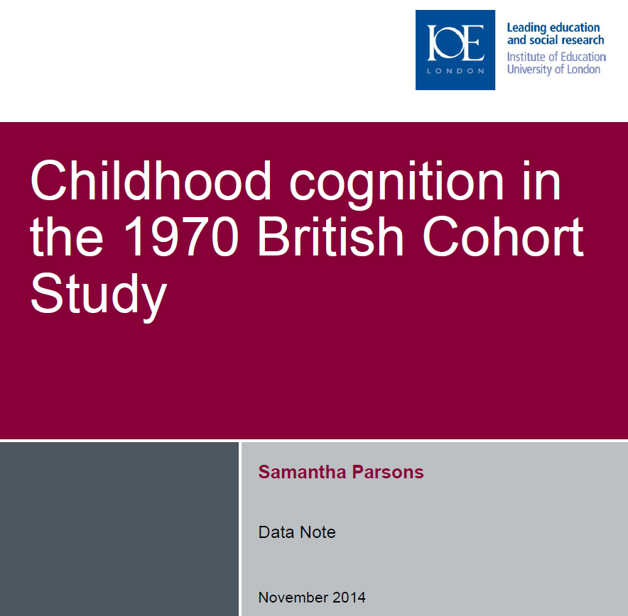

See data notes
Link
Link

Slide 9
A mid-life biomedical sweep at 46 years (MRC/ESRC funded)
Themes
  Understanding health inequalities
  Causes and consequences of overweight and obesity
  Activity, sedentary behaviour and fitness
  Wellbeing, sleep and mental health
A baseline for ageing, comparisons with other cohorts

Slide 10
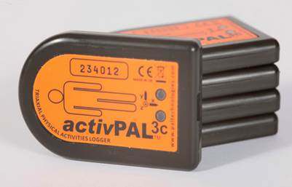
Age 46 Survey Content (N=8,581)
  Questionnaire:
    Household composition, relationships:
    Finances and employment:
    Health, well-being and cognition:
      Physical & mental health, mental wellbeing, medical care, medication, smoking, drinking, diet, exercise, cognitive function (as per NCDS Age 50)
      Word list recall – immediate and delayed memory; Animal naming – executive function; Letter cancellation – concentration / attention to detail
  Nurse measures:
    Anthropometry, physical function (grip, balance), blood pressure (sitting), blood sample, accelerometry (ActivPal for 7 days)
  Online diet questionnaire (Oxford WebQ: 2x24 hour recall)
  Link to questionnaires
  Main data available June 2019; Dec 2019 for accelerometery
Notes:
Funding: ESRC, MRC, NIH,DWP

Slide 11
High mental distress (Malaise) –
1958 and 1970 cohorts at 42
Ploubidis et al 2017
Sacker & Wiggins, 2002

Slide 12



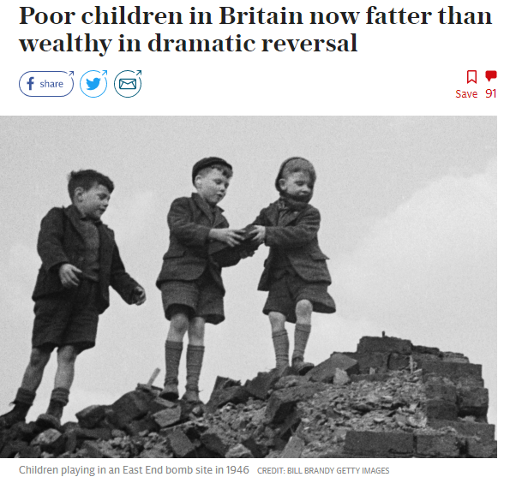


Some recent findings

Slide 13
Next up – Age 50 Survey (2020-21)
  Face to face interview – 75 minutes
  Cross-cohort comparability with:
    1958 cohort at 50y (2008)
    1946 cohort at 53y (1999)
  Piloting and development – 2019
    Additional consultation shortly on our draft
  Main stage of data collection – 2020-21

Slide 14
Thank you
Any questions?

