Slide 1
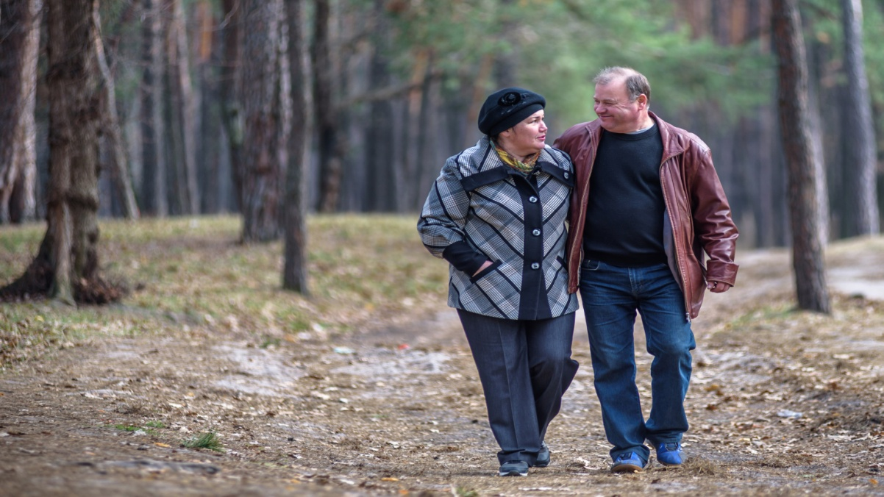
An Introduction to the 1970 British Birth Cohort (BCS70)
4th June 2018
David Bann

Slide 2

Brief Overview of BCS70
Data collected about births and families of just over 17,000 babies born in England, Wales, Scotland and Northern Ireland in one week in 1970
N.Ireland members not followed up after birth (unless moved to mainland)
Early focus was medical & has broadened :
Childhood : educational and physical development
into adulthood: Family formation, employment...
Formation and maintenance of adult identity.
PI: Alice Sullivan
Lead study manager: Matt Brown

Slide 3
Early unequal (cognitive) trajectories
Evidence from BCS70 showing that many bright children from poor families were overtaken by less able children from affluent backgrounds by age 6 was included in the Every Child Matters Green Paper in 2003 and helped to underpin the case for greater investment in pre-school provision.
Feinstein, 2003
see also Jerrim & Vignoles, 2012

Slide 4
High mental distress (Malaise) –
1958 and 1970 cohorts at 42
Ploubidis et al 2017
Sacker & Wiggins, 2002

Slide 5
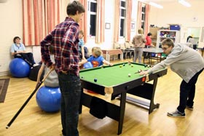
Policy relevance
Mental health - Half of those with mental health problems at age 26 developed a psychiatric disorder by age 34. Policy-makers responded to this finding with a commitment to early intervention aimed at promoting better mental health and wellbeing.
Careers advice - Research showing how prolonged periods of being out of education, employment or training after leaving school have long-term negative consequences for employment and mental health featured in 1999 Social Exclusion Unit report, Bridging the Gap, which led to the creation of the Connexions service.
Youth policy - The government’s ‘Youth Matters’ policy, launched in 2005 to improve local facilities for teenagers, was based partly on BCS70 evidence showing that teenagers’ involvement in structured leisure activities can have lasting benefits.

Slide 6
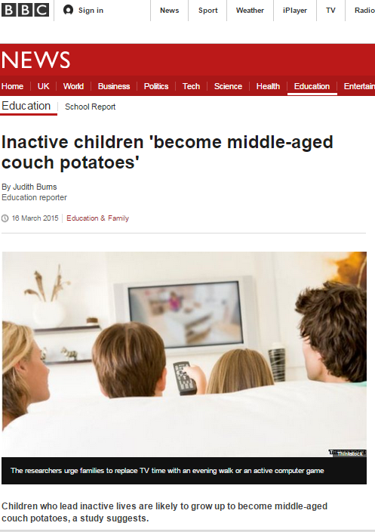
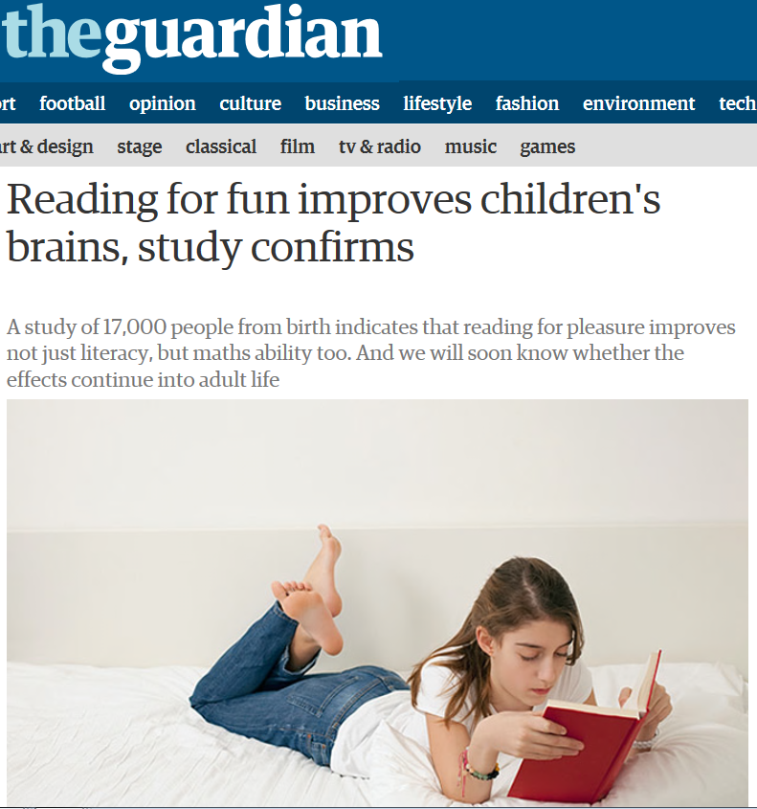
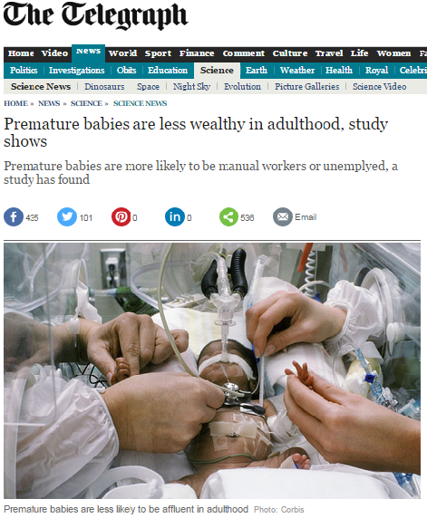
Some recent findings

Slide 7

Sources of information
1970 | 1975 | 1980 | 1986 | 1996 | 2000 | 2004 | 2008 | 2012 | 2018
Birth | 5 | 10 | 16 | 26 | 29/30 | 34 | 38 | 42 | 46
Parent | Parent School | Parent School | Parent School Cohort member | Cohort member | Cohort member | Cohort member Children (1 in 2) | Cohort member | Cohort member | Cohort member
Medical | Tests Medical | Tests Medical | Tests Medical |  |  |  |  | Tests | Tests Medical
Respondents
Instruments

Slide 8
Participation/response in BCS70 across life
Telephone
Missing data:
Reduces power and potentially introduces bias
Increasingly researchers can address this using data which predicts missingness (eg, early life socioeconomic circumstances)
eg, multiple imputation, FIML, inverse probability weighting
Postal
Telephone
Birth
5
10
16
26
30
34
38
42

Slide 9
Topics covered by life stage
Birth | School years | Adult
Family Parental employment Obstetric history Smoking in pregnancy Pregnancy (problems, antenatal care) Labour (length, pain relief, problems) Birth (problems, sex, weight, length) | Family Parental employment Financial circumstances Housing Health Behaviour School Views and expectations Attainment | Family (partners, children) Employment Income Housing Health Health-related behaviour Courses and qualifications Basic skills Cognitive ability Views and expectations

Slide 10
Childhood Topics 1
Parents | Birth | General
Smoking (0, 5, 10, 16) Drinking (10, 16) Pregnancy history Maternal mental health (5, 10, 16) | Smoking in pregnancy Pregnancy Labour Birth weight / length etc Problems at birth Breastfeeding | General health Child development Specific conditions Disabilities/ special needs Hospital admissions Use of services Immunisation Medication Accidents Menstruation

Slide 11
Childhood Topics 2
Childhood physical assessments | Lifestyle | Behavioural and mental
Height (5,10,16) Weight (5,10) Head circumf (5,10,16) Audiometry (10, 16) Laterality Speech Co-ordination Blood pressure/ pulse Vision | Diet (10, 16) Eating problems (5; 10; 16) Exercise (10, 16) Sedentary behaviour (5,10,16) Dental and physical hygiene (16) Sexual activity (16) Smoking (10, 16) Drink and Drugs (16) | Behavioural problems (5, 10) Mental health (10, 16) Wellbeing (16) Personality (10) Locus of control, self-esteem, social judgement (10) Sleeping problems (5,10,16)

Slide 12
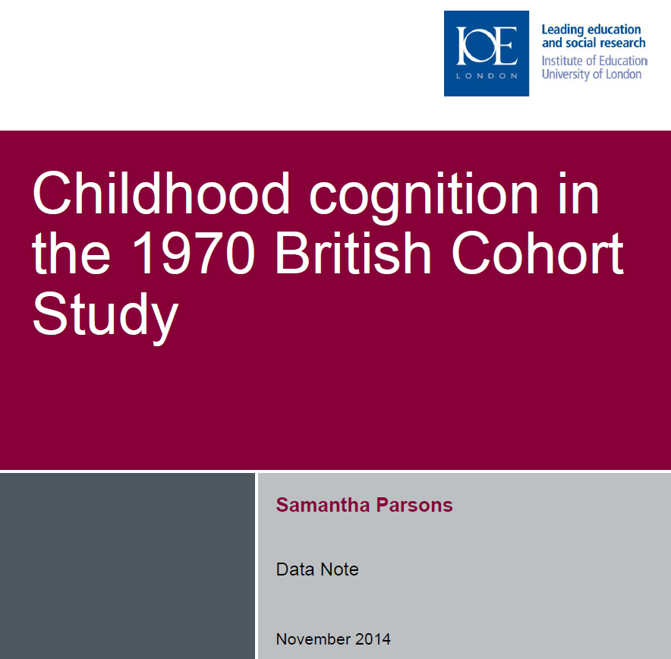
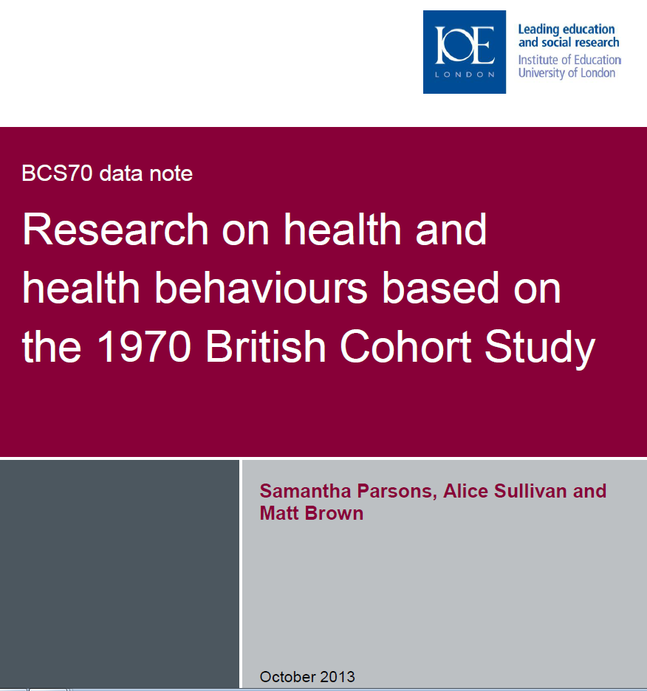
See data notes
+ CLS working paper series

Slide 13
Age 42 survey 60 minute ‘core’ interview - health
Repeated content | New
Self-reported general health Long-standing illnesses Disability Mental health problems Drinking Smoking Exercise Height / Weight (Self-reported) Well-being / depression | Menopause / gynaecological problems Fertility intentions Use of infertility treatments Sports participation Diet – breakfast, ready-meals, convenience foods, take-aways, home-cooked meals Sleep

Slide 14
Age 42 survey - other
Repeated content | New
Partnerships Housing Children Family – caring for parents, social networks Employment / Income Qualifications Voting Values / attitudes Vocabulary assessment | Housing costs / housing equity Identity – social class / sexuality Cultural consumption – books / newspapers / TV Beliefs - belief in God / the afterlife

Slide 15
A mid-life biomedical sweep at 46 years (MRC/ESRC funded)
Fieldwork ongoing, data deposit TBC (2018-2019)
Themes
  Understanding health inequalities
  Causes and consequences of overweight and obesity
  Activity, sedentary behaviour and fitness
  Wellbeing, sleep and mental health

Slide 16
Key measures
Demographic, family, and socioeconomic data
Blood for analytes and DNA (cholesterol and hba1c with initial deposit)
Blood pressure, resting heart rate
Online dietary diary
Cognition
Grip strength, standing balance
Height, weight, body fat, waist measurements
  Health (General health/Disability/Physical health conditions/Mental health conditions/Well-being/Medication/Hospitalisation/Dental health/Menopause)
Lifestyle factors, sleep
Physical activity/sedentary behaviour (activPAL accelerometer)

Slide 17
Thank you
Any questions?

Slide 18
Appendix

