Slide 1

An Introduction to Next Steps
Principal Investigator: Dr. Lisa Calderwood
Co-Investigator: Morag Henderson

Slide 2
Timeline of the studies
Next Steps follows the lives of around 16,000 young people living in England who were born in 1989/90.
National Child Development Study 1958
Birth Cohort Study 1970
Next Steps
Millennium Cohort Study
1920 | 1940 | 1960 | 1980 | 2000 | 2020
Notes:
The missing cohort

Slide 3
  Why is Next Steps important?
The “missing” cohort – young people born in the early ‘90s
Only major national longitudinal study focussing on pathways through the teenage years and transitions into adulthood
Has already been extensively used by analysts and policy makers across government
Notes:
So, why is the study continuing after all of this time?
Continuing Next Steps is of key scientific and strategic importance for UK social science.
The UK has a long history of running studies like Next Steps. The earliest study began in 1946, to study the post-War generation. Since then, studies have been following those born in 1958, 1970, and 2000. And the tradition continues today – the most recent study of this kind began in 2014. CLS runs three of these studies, which are also funded by ESRC.
However, unfortunately there was a 30-year gap in this tradition between 1970 and 2000. By continuing to follow the lives of those born in 1989-90, Next Steps will fill in this gap and greatly improve our understanding of how British society and lives are changing from generation to generation. They are the missing cohort we need to complete the story of Britain.
Additionally, people born in 1990 have experienced circumstances and challenges that are unique to their generation. Often referred to as the Millennial generation they grew up during the first major advances in the internet, social media and new technology. The opportunities of globalisation, cultural diversity and equal rights have also grown rapidly during their lifetimes. But it has not been a generation without challenges. They entered the workforce during the worst economic recession since the Great Depression. The global War on Terror broke out, and social inequalities persisted in countries across the world.
By following this group into adulthood, researchers will be able to understand how our experiences as teenagers affect how we turn out later on and gaining a better understanding of the lives of this group will enable government to evaluate the success of policies aimed at this group of adults. We hope to be able to continue following them throughout their adult lives, building an even more complete picture of what life is like for this generation.

Slide 4
  Important study following lives of 16,000 people born in England in 1989-1990
Began in 2004 when study members were aged 13-14 and in Year 9
Surveyed annually until 2010 when they were aged 19/20
Age 25 available March 2017
Scientific planning for age 31/32 underway
Notes:
Next Steps is an important study following the lives of around 16,000 people born between 1989 and 1990.
Run by Department for Education
It began in 2004, when the study members were aged 13-14 years and in Year 9 at school. They were recruited through schools. A total of 647 state and independent secondary schools as well as pupil referral units participated in the first wave of the study. Around 15,700 (15,770) young people took part in 2004, and 2007 an additional boost sample of around 350 Black Caribbean and Black African pupils were recruited to the study. So, in total 16,122 people have ever taken part in the study.
Following the initial survey at age 13-14, the study members were visited every year until 2010, when they were age 19-20, so there have been seven waves of the study so far. Age 25 will be the eighth time they have been contacted.
In waves one to four, the survey was conducted via face to face interviewing and included interviews with the study members’ parents. In the last three wave (5, 6 and 7) it was only the study member who was interviewed. These waves used a mixed mode approach in which the young person could complete the interview either online, over the telephone or face to face as they had previously.
Next Steps is what is known as a cohort study. It follows the same generation of people over time. We refer to study members as cohort members.
In 2013 management taken over by CLS -

Slide 5
  Next Steps study and sample design
Year 9 pupils attending maintained and independent schools, and pupil referral units – 2 PRUs
Maintained schools: 2 stage probability proportional to size (PPS) with disproportionate stratification using Pupils Level Annual School Census (PLASC) – 838 schools
  Schools = PSU
    “Deprived” oversampled, defined by % FSM top quintile
  Pupils within schools – oversampled minority ethnic groups (average 33.25)
Independent schools selected from the School Level Annual School Census (SLASC) - 52 schools
Weighting: Each sweep; PSU and Stratum
Notes:
- Overall maintained 838 schools, 52 independent, 2 pru’s
Response 647 schools (73%)
Booster sample wave 4 ethnic minorities

Slide 6




Next Steps A study of young people born in 1989/90
2020…
Age 31/32
2004 | 2005 | 2006 | 2007 | 2008 | 2009 | 2010 |  | 2017
Age 14 | Age 15 | Age 16 | Age 17 | Age 18 | Age 19 | Age 20 |  | Age 25
Young person | Young person | Young person | Young person | Young person | Young person | Young person |  | Young adult | Adult
Main parent | Main parent | Main parent | Main parent
 |  | National Pupil Database |  |  |  |  |  | Linkage consents sought
15,770 | 13,539 | 12,439 | 11,801 | 10,430 | 9,799 | 8,682 |  | 7,701
74% | 86% | 92% | 92% | 89% | 87% | 90% |  | 50%
main respondent
Parent response
Linked data
sample
response rate
Notes:
Initial sample at wave 1 was 21000 young people –
The Next Steps data has also been linked to National Pupil Database (NPD) records, which include the cohort members' individual scores at Key Stage 2, 3 and 4. Next Steps is managed by CLS and funded by the Economic and Social Research Council
And KS5 attainment…. NB Secure data access
Linkage consents sought
National Pupil Database
Individual Learner Record
Higher Education Statistics Agency
UCAS, DWP…

Slide 7
Available Data: Topics covered by life stage
School years | Early Adulthood
Family Parental employment Financial circumstances Housing Health Behaviour Educational attainment Educational aspirations Subject choice Views and expectations Parental reports on relationship Bullying | Educational transitions Family (partners, children) Employment Income Housing Health Courses and qualifications Sexual identity Political engagement Locus of control

Slide 8
Research questions at age 25
How this generation has experienced a severe global recession
How to combat the growth of obesity
How to reduce inequalities
How to confront problems of mental health
How this generation is getting on in the labour market
How to ensure appropriate skills acquisition
Notes:
At age 25, the cohort are at an important transitional period in their lives, where they can take many different routes and are likely to be taken big decisions about their future for example about careers, housing, families and finances.
We’ll talk more about the content of the age 25 survey shortly. But this slide gives just few of the research questions that academics and policy-makers will be able to use the information for.
As I’ve already mentioned this generation entered the workforce during a severe global recession so one of the key research questions will be to look at the impact this has had on them – and in particular how they are getting on in the labour market. There is a lot of concern about things like under-employment for example graduates not being able to get onto a career ladder and instead having to take unskilled work and also the treatment of young people by employers so things like zero hours contracts.
Mental health and obesity are two of the biggest public health challenges facing the UK population – and there is particular concern about this generation and age group.
The skills of young adults in the UK is also an area of concern – and in particular whether they have the right skills for the labour market. The UK ranks very low in recent OECD international surveys of skills such as PIAAC so ensuring appropriate skills acquisition is important for research and policy.
Finally, reducing inequalities for example between different social and ethnic groups is also a key concern, and in particular tracking whether inequalities that emerged when they were at school have persisted into adult life.
More generally, the data will be used for a range of different research and policy and ultimately to improve public services and making sure we learn from the experiences of this generation to help the next. As already mentioned, we compare this generation to other generations who are being following in other longitudinal birth cohorts.

Slide 9
Topics covered (45 minute interview)
Household formation, relationships and fertility
Housing
Employment, income, education and training
Identity and participation
Health and well-being
Data linkage consents
Contact information
Gender identity
Drug consumption
Locus of control
Sexual behaviour
Life satisfaction
Self-harming
Drinking behaviour
Crime and harassment
Smoking behaviour
Pregnancy history
Notes:
Mention event history calendar/collection of histories.
Sensitive questions – gender identity, locus of control, life satisfaction, drinking, smoking, drug consumption, sexual behaviour, self-harm, crime and harassment, pregnancy history.

Slide 10
Final sample sizes and response rates
Mode | Issued sample | Number of interviews | Overall RR | Mode RR | Proportion of achieved sample
Web | 15,531 | 4,720 | 31% | 31% | 61%
Telephone | 5,297 | 664 | 4% | 13% | 9%
F2F | 10,357 | 2,323 | 15% | 23% | 30%
Overall | 15,531 | 7,707 | 50% | N/A | 100%
Notes:
Web and Tel = approx. 20% of total cost
F2F = 80% of total cost
Web = 10%
Tel = 20%
F2F = 70%

Slide 11
Video introducing Next Steps
www.nextstepsstudy.org.uk
Notes:
We’ve produced a video for cohort members to remind them of the importance of the study and encourage them to take part. We’d like to show it to you now.

Slide 12
Data linkage consents obtained by mode
Domain | Web (%) | Telephone (%) | F2F (%) | Overall (%) | Overall (N)
Education (NPD, ILR, HESA) | 61 | 85 | 86 | 70 | 5,283
Education (UCAS) | 58 | 84 | 83 | 68 | 5,077
Education (SLC) | 50 | 74 | 77 | 60 | 4,498
Health (NHS) | 55 | 76 | 83 | 65 | 4,893
Economic (DWP) | 48 | 76 | 78 | 60 | 4,457
Economic (HMRC) | 46 | 71 | 76 | 57 | 4,287
Crime (MOJ) | 55 | 78 | 79 | 64 | 4,775
Notes:
NINO – 44% in web. 46% in Tel, 64% in F2F, 50% overall

Slide 13


In the news
Saturday jobs’ can damage grades for teenagers’ (Guardian, 28 March 2015)
New research suggests that teenagers who take on a Saturday job could be damaging their GCSE grades – an effect especially noticeable in girls. This research, conducted by Dr Angus Holford at the University of Essex made use of data from Next Steps

Slide 14
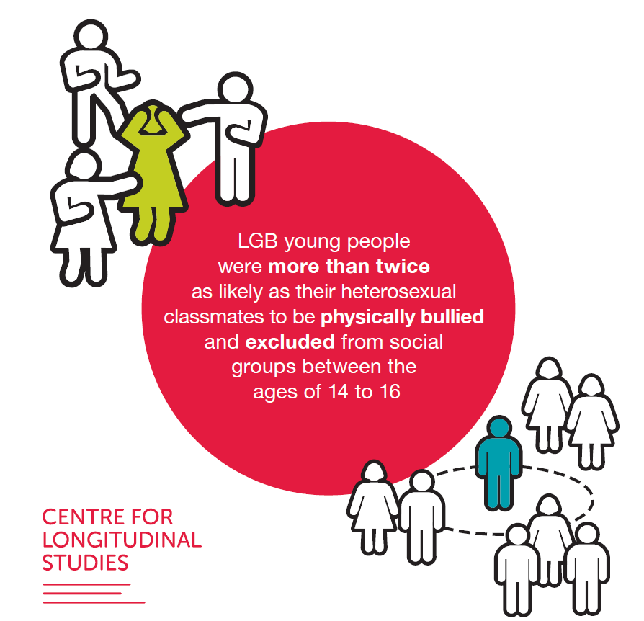
In the news
Sexual minorities more at risk of being bullied than heterosexual peers
Research using Next Steps data suggests that young people who identify as sexual minorities are at a greater risk of ever experiencing bullying and experiencing bullying frequently during compulsory schooling and in early adulthood.

Slide 15

Subject Choice
Alice Sullivan; Morag Henderson; Jake Anders; and Vanessa Moulton
Strong income effect in predicting curriculum choice at age 14: low income, less selective curriculum (Working paper, Henderson et al. 2017)
Curriculum selection influences post-16 transitions. Increased probability of some groups more selective education (Moulton et al. 2018)
School effects (Anders et al. 2018)
Matching paper (Anders et al. 2018)
Notes:
Assume when you speak to it you would mention that part of the CCRP (though not everyone will know what this is)

Slide 16
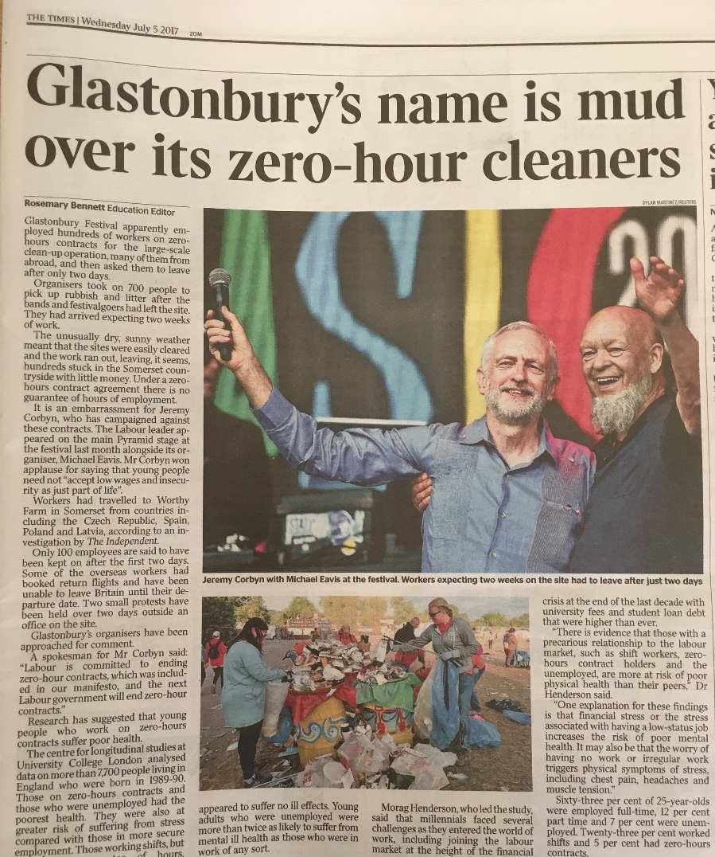
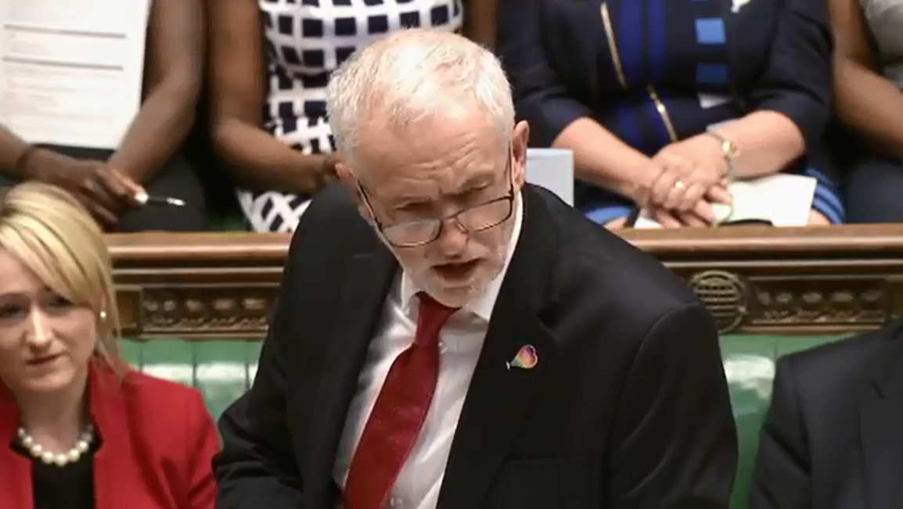
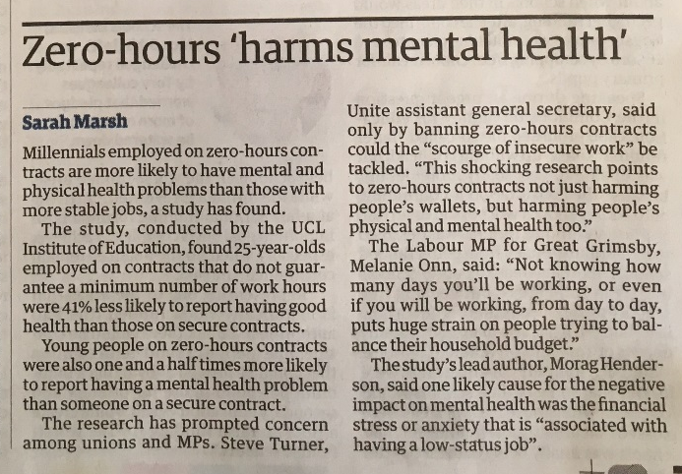
Zero-hours contracts
Having a zero-hours contract and being unemployed were associated with poorer self-assessed general health, after taking into account individual and behavioural characteristics
Shift workers, those with zero-hours contracts and those who were unemployed were at a greater risk of reporting poor mental health after taking into account individual and behavioural characteristics

Slide 17
Thanks to our funders and host institution
Funded by
Hosted by
www.esrc.ac.uk
www.ioe.ac.uk

Slide 18
Thank you
Any questions?

